Slide 1

Pengenalan Pola
Pattern Recognition
Mohammad Nasucha, S.T., M.Sc., Ph.D.
Program Studi Informatika
Universitas Pembangunan Jaya

Slide 2
M07
Object Classification Using Artificial Neural Network (1)
Introduction to ANN
What is Object Classification?
Understanding the ANN in Details
Designing an ANN Model
Realizing the ANN Model in Programming

Slide 3
M07
Object Classification Using Artificial Neural Network (1)
Introduction to ANN
What is Object Classification?
Understanding the ANN in Details
Designing an ANN Model
Realizing the ANN Model in Programming

Slide 4
Introduction to (Artificial) Neural Network
The neural network concept has been around for several decades, and it is difficult to attribute the invention of neural networks to a single person.
However, the modern form of neural networks is usually attributed to the work of Warren McCulloch and Walter Pitts in the 1940s published in their paper "A Logical Calculus of the Ideas Immanent in Nervous Activity," published in the Bulletin of Mathematical Biophysics in 1943.
In that paper, McCulloch and Pitts proposed a mathematical model of a neural network based on the workings of the brain. Their model consisted of simple binary threshold neurons, and it demonstrated that such a network could perform simple logical operations.
On that idea, many researchers then have developed different types of neural networks, including CNN, RNN and LSTM.

Slide 5
Introduction to ANN
The word “Artificial Neural Network (ANN)” is the new term for the “Neural Network (NN)”.
ANN is the core algorithm for deep learning.
In general ANN is used for object detection, object classification / recognition, and data prediction.
The branches of ANN includes Convolutional Neural Network (CNN), Recurrent Neural Network (RNN), and Long Short-Term Memory (LSTM). The LSTM itself is a branch of the RNN.
CNN is commonly used for object classification / recognition (computer vision).
RNN is specifically used for time-series data processing such as in natural language processing, and speech recognition.

Slide 6
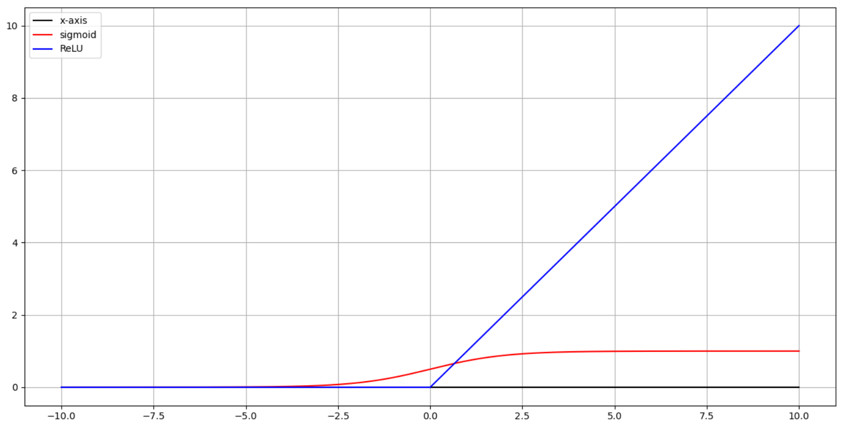
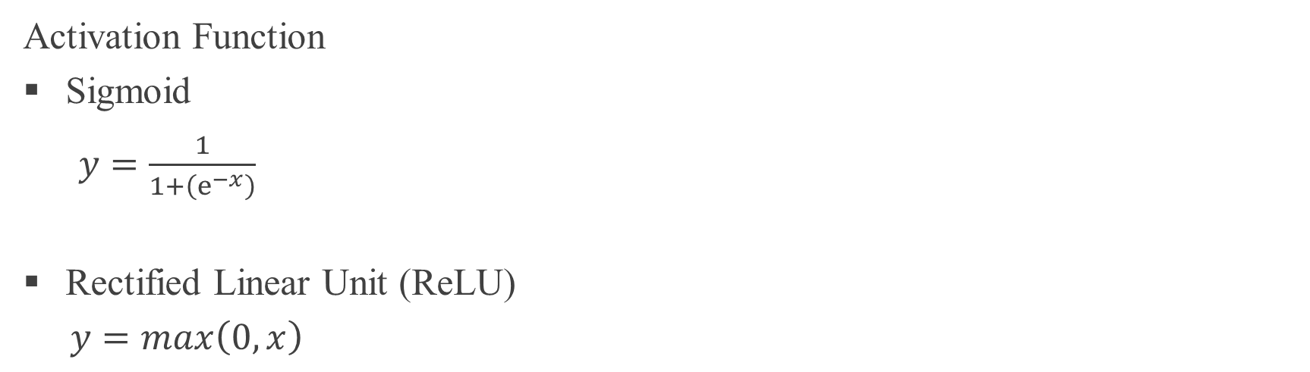
Introduction to ANN
Activation Function
Sigmoid
$y=\frac{1}{1+\left(ⅇ^{−x}\right)}$
Rectified Linear Unit (ReLU)
$y=max\left(0, x\right)$

Slide 7
M07
Object Classification Using Artificial Neural Network (1)
Introduction to ANN
What is Object Classification?
Understanding the ANN in Details
Designing an ANN Model
Realizing the ANN Model in Programming

Slide 8
Object Classification: Handwriting of Number 0, 1, 2, 3 …9
Take a look at the following case.
A number of researchers collected 60,000 images of handwriting, where each image contains a single number, either 0, 1, 2, 3, 4, 5, 6, 7, 8 or 9). Each image is a grayscale picture of 28x28 pixels where the value of each pixel is a float between 0 and 1.
In the same time 60,000 pieces of labels were also prepared to tell the ANN program the right classification of every image. Technically, each label is also a grayscale image, with smaller size, i.e. 10x1 pixels where the value of each pixel is also float between 0 and 1. For example the label “0” is an image with pixel value 1 0 0 0 0 0 0 0 0 0. The label “1” has pixel value 0 1 0 0 0 0 0 0 0 0, and so on.
The result (output) of the ANN process for each image will be unlikely exactly 0 or 1 but would be a float, such as 0,876 0,123 0, 213 0 0 0 0 0 0 0. The difference between these output numbers and the pixel values of the label will tell whether the learning state is already good or not.

Slide 9
Object Classification: Handwriting of Number 0, 1, 2, 3 …9
The skills in realizing NN theory into programming requires a key knowledge, that is, the knowledge of matrix operations.

Slide 10
M07
Object Classification Using Artificial Neural Network (1)
Introduction to ANN
What is Object Classification?
Understanding the ANN in Details (1 Hidden Layer)
Designing an ANN Model
Realizing the ANN Model in Programming

Slide 11

Forward Propagation: Input → Hidden (1)
Matrix Operations
The img matrix is [784x1], which is a vertical vector.
The hidden matrix is [20x1], which is a vertical vector too.
Then, what is the shape of the “wih” matrix?
How to Find the Shape of wih
wih.img = hidden
[? x ?] . [784x1] = [20x1]
[20x784] . [784x1] = [20x1] #according to matrix theory.
Thus the shape of “wih” matrix is here defined as 20x784.
Note
The matrix operation will be alright whatever the number of hidden layer’s neurons.
The number of hidden layer’s here is intuitively 20. It should be studied further how to determine it by referring to new research findings.
bias = 1
bih[0]
bih[1]
bih[19]
bih[2]
img[0]
wih[0,0]
h[0]
wih[0,1]
img[1]
wih[0,2]
h[1]
wih[0,3]
img[2]
h[2]
img[3]
wih[0,783]
h[19]
wih[1,783]
wih[19,783]
img[783]

Slide 12
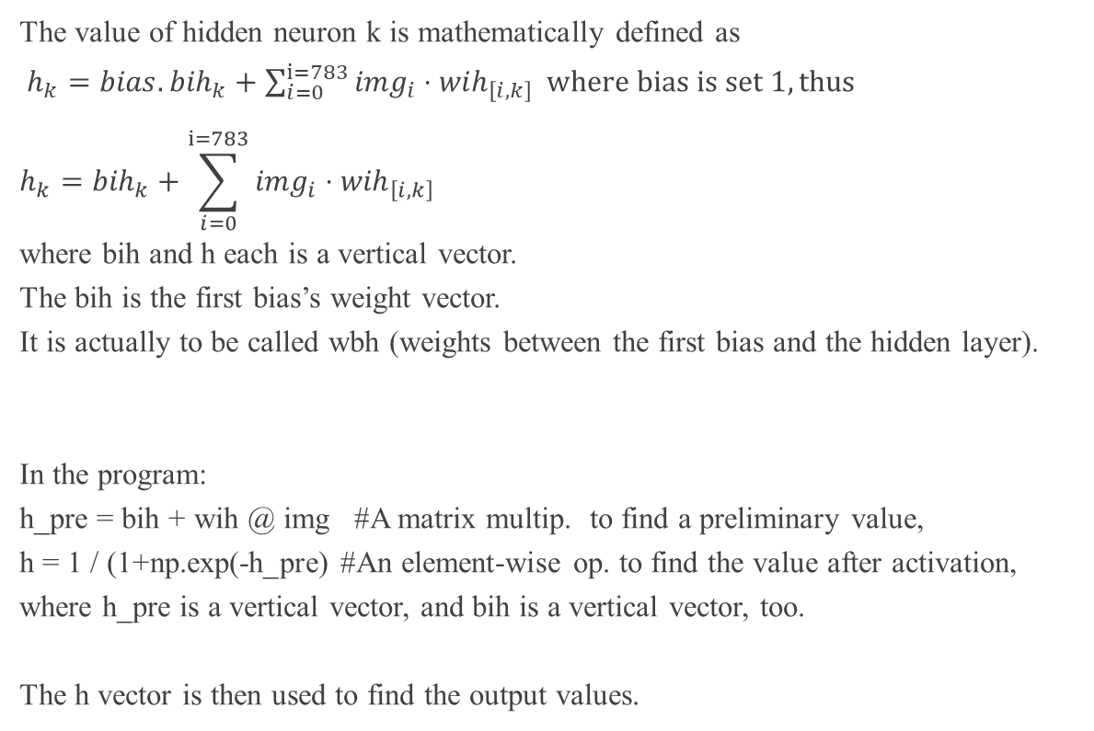
Forward Propagation: Input → Hidden (2)
Math and Programming
The value of hidden neuron k is mathematically defined as
$h_{k}=bias.{bih}_{k}+\sum_{i=0}^{i=783}{{img}_{i}}⋅{wih}_{\left[i,k\right]} where bias is set 1, thus$
$$h_{k}={bih}_{k}+\sum_{i=0}^{i=783}{{img}_{i}}⋅{wih}_{\left[i,k\right]}$$
where bih and h each is a vertical vector.
The bih is the first bias’s weight vector.
It is actually to be called wbh (weights between the first bias and the hidden layer).
In the program:
h_pre = bih + wih @ img #A matrix multip. to find a preliminary value,
h = 1 / (1+np.exp(-h_pre) #An element-wise op. to find the value after activation,
where h_pre is a vertical vector, and bih is a vertical vector, too.
The h vector is then used to find the output values.
bias = 1
bih[0]
bih[1]
bih[19]
bih[2]
img[0]
wih[0,0]
h[0]
wih[0,1]
img[1]
wih[0,2]
h[1]
wih[0,3]
img[2]
h[2]
img[3]
wih[0,783]
h[19]
wih[1,783]
wih[19,783]
img[783]

Slide 13
Forward Propagation: Hidden → Output (1)
Matrix Operations
The hidden matrix is [20x1], which is a vertical vector.
The output matrix is [10x1], which is a vertical vector, too.
Then, what is the shape of the “who” matrix?
Analysis
who.hidden = output
[? x ?] . [20 x 1] = [10 x1]
[10 x 20] . [20 x 1] = [10 x 1] #according to matrix theory
Thus the shape of “who” matrix is here defined as 10x20.
bias = 1
bho[0]
bho[1]
bho[2]
bho[9]
h[0]
who[0,0]
o[0]
who[0,1]
h[1]
who[0,2]
o[1]
h[2]
oh[2]
who[0,19]
o[9]
who[9, 19]
h[19]

Slide 14

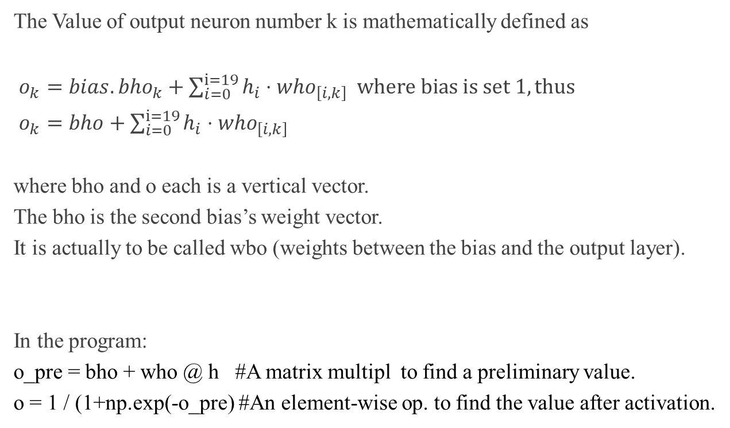
Forward Propagation: Hidden → Output (2)
Math and Programming
The Value of output neuron number k is mathematically defined as
$o_{k}=bias.{bho}_{k}+\sum_{i=0}^{i=19}{h_{i}}⋅{who}_{\left[i,k\right]} where bias is set 1, thus$
$o_{k}=bho+\sum_{i=0}^{i=19}{h_{i}}⋅{who}_{\left[i,k\right]}$
where bho and o each is a vertical vector.
The bho is the second bias’s weight vector.
It is actually to be called wbo (weights between the bias and the output layer).
In the program:
o_pre = bho + who @ h #A matrix multipl to find a preliminary value.
o = 1 / (1+np.exp(-o_pre) #An element-wise op. to find the value after activation.
bias = 1
bho[0]
bho[1]
bho[2]
bho[9]
h[0]
who[0,0]
o[0]
who[0,1]
h[1]
who[0,2]
o[1]
h[2]
oh[2]
who[0,19]
o[9]
who[9, 19]
h[19]

Slide 15

Backward Prop: Hidden ← Output
How to update b_h_o and w_h_o after a training epoch:
delta_o = o – l
#o is the output vector (vertical) and l is the label vector (vertical).
bho += -learn_rate * delta_o #Bec. the bias value is 1 for all.
bho += -learn_rate * delta_o @ np.transpose(bias) # If bias were a vertical vector.
#delta_o is a vertical vector, bho is a vertical vector too.
who += -learn_rate * delta_o @ np.transpose(h)
#If the input value is big, its related weight will be reduced much.
#If the input value is small, its related weight will be reduced less.
bias = 1
bho[0]
bho[1]
bho[2]
bho[9]
h[0]
who[0,0]
o[0]
who[0,1]
h[1]
who[0,2]
o[1]
h[2]
oh[2]
who[0,19]
o[9]
who[9, 19]
h[19]

Slide 16

Backward Prop: Input ← Hidden
bias = 1
bih[0]
bih[1]
bih[19]
bih[2]
How to update b_i_h and w_i_h after a training epoch:
delta_h = np.transpose(w_h_o) @ delta_o * (h * (1 – h))
b_i_h += -learn_rate + delta_h
w_i_h += -learn_rate + delta_h @ np.transpose(img)
img[0]
wih[0,0]
h[0]
wih[0,1]
img[1]
wih[0,2]
h[1]
wih[0,3]
img[2]
h[2]
img[3]
wih[0,783]
h[19]
wih[1,783]
wih[19,783]
img[783]

Slide 17
Thank you.

